Slide 1





INST 627
Data Analysis of Airline On-Time Performance
- Akshay Mandke
- Krishnesh Pujari
- Mohit Juneja
Notes:
1

Slide 2
OVERVIEW OF THE PROBLEM STATEMENT
Bureau of Transportation Statistics (BTS) works with Congress, public and private sector partners, and stakeholder groups to create a safe transportation system that contributes to livable communities.
The data we analyze will be used to increase the Nation’s understanding of airline transportation statistics and to better inform decision- and policymakers.
The dataset contains airline statistics across United States and the scope of the data set under our study is from January 2014 through December 2014
Various parameters such as destinations, airports, time, delays etc. for all the states are evaluated from this dataset
Notes:
2

Slide 3
MOTIVATION
87,000 on air flights are noted in the United States per day. Approximately 7,300 airport terminal monitors needed to show all the flights controllers handle and approximately 460 monitors to show the number of flights being handled at any one time.
To make convenience for people who often travel by air, we aim to notice from our dataset that flights of some certain routes or some certain airlines are really more likely to be late than others due to several types of delays.
Our research will find out major reason of flights/airlines being late so that people could avoid them the next time they choose a flight and our conclusions can help people quickly and accurately find the best flight for their travel.
Notes:
3

Slide 4
METHODS
1st Research Question:
Performed one-way ANOVA since the study design involved one dependent variable (DELAY_IN_MIN) and one independent variable(TYPE_OF_DELAY).
Determined if there are any significant differences between the means of 5 independent (unrelated) groups.
Using post-hoc test, to determine which of the group differ significantly from each other.
t-tests can also be used, but in that case 10 t-tests would be needed to perform to compare 5 samples.
Notes:
4

Slide 5
METHODS
2nd Research Question:
Performed one-way ANOVA since the study design involved one dependent variable (ARR_DELAY) and one independent variable (AIRLINE_ID).
Large number of t-tests would have to be performed, if that statistical concept is used.
Using post-hoc test, to determine which of the group differ significantly from each other
3rd Research Question:
Study design involved two independent (categorical) variable and one dependent (continuous) variable, so used two-way ANOVA
Treated CRS_DEPT_TIME as categorical variable measured on nominal scale.
Understand if there is an interaction between the two independent variables (DAY_OF_WEEK and CRS_DEPT_TIME) on the dependent variable (ARR_DELAY_NEW)
Notes:
5

Slide 6
ANALYSIS
Factor most impacting the airline on-time performance
Null hypothesis (H0): There is no significant difference in the impact posed by the factors on the On-time Airline performance
Alternative hypothesis (Ha): There is a significant difference in the impact posed by the factors on the On-time Airline performance
Descriptive
DELAY_IN_MIN
 | N | Mean | Std. Deviation | Std. Error | 95% Confidence Interval for Mean |  | Minimum | Maximum
 |  |  |  |  | Lower Bound | Upper Bound
CARRIER_DELAY | 3969 | 62.99 | 87.989 | 1.397 | 60.25 | 65.73 | 15 | 1031
WEATHER_DELAY | 211 | 57.35 | 46.033 | 3.169 | 51.10 | 63.60 | 15 | 302
NAS_DELAY | 5455 | 41.33 | 43.891 | .594 | 40.16 | 42.49 | 15 | 482
SECURITY_DELAY | 14 | 23.86 | 9.197 | 2.458 | 18.55 | 29.17 | 15 | 41
LATE_AIRCRAFT_DELAY | 453 | 65.43 | 71.077 | 3.339 | 58.87 | 72.00 | 15 | 634
Total | 10102 | 51.23 | 66.857 | .665 | 49.93 | 52.54 | 15 | 1031
Notes:
6

Slide 7
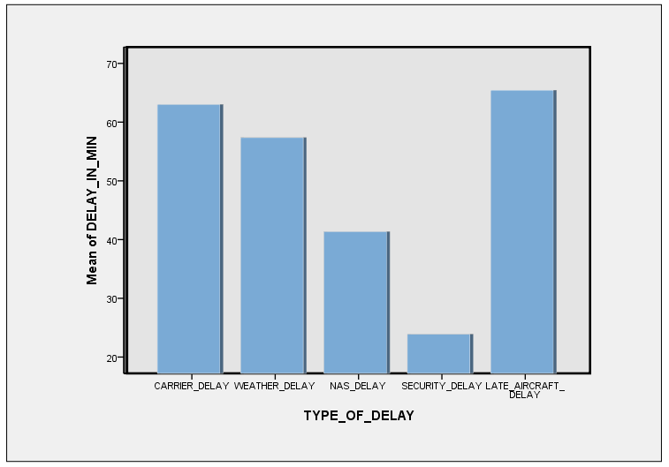
ANALYSIS
ANOVA
DELAY_IN_MIN
 | Sum of Squares | df | Mean Square | F | Sig.
Between Groups | 1193634.507 | 4 | 298408.627 | 68.546 | .000
Within Groups | 43956596.535 | 10097 | 4353.431
Total | 45150231.042 | 10101
Notes:
7

Slide 8
ANALYSIS
We have performed One Way ANOVA since, we analyzed randomly separated groups consisting different participants, and exposed to different conditions to measure the same dependent variable.
The Descriptive statistics table shows the Mean, Standard deviation and the Lower and the upper bound values for each cause of impact on the airline on-time performance.
The ANOVA table depicts that the significance value id less than α = 0.05 (significance level considered in our test). Hence, it proves that there is a statistical significance difference between the average means of each cause of delay.
So we reject the null-hypothesis (Ho) assumed earlier, that there is no significance difference between the impact imposed by the cause of delay.
Notes:
8

Slide 9
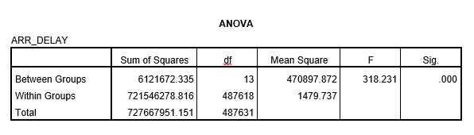
ANALYSIS
To determine the airline that has experienced less delays over the year 2014.
Null hypothesis (H0): There is no significant difference in the mean of the delays experienced by the airlines
Alternative hypothesis (Ha): At least one airline differs significantly from the other airlines, in terms of delay.
Notes:
9

Slide 10
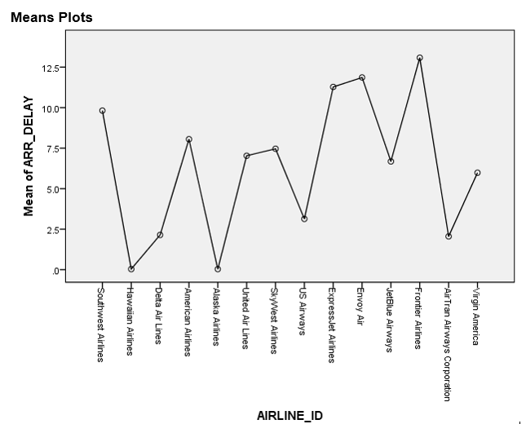
ANALYSIS
Notes:
10

Slide 11
ANALYSIS
In this analysis we have identified the delay factor i.e. the Arrival delay and compared it with the independent variable i.e. the airline company to provide the performance statistics with respect to delay for each organization.
We conducted one-way ANOVA statistical test and analyzed that there is a significance difference between the delay incurred by the airplanes for each airline company (assuming significance level α = 0.05). So we reject our null hypothesis.
By using descriptive statistics as showed in the plot above we identified Frontier Airlines company when compared to others which fail majorly to provide on-time performance
Notes:
11

Slide 12
ANALYSIS
Impact of factors like departure time and the day of the week on airline on-time performance
Null hypothesis (Ho): Departure time and day of the week has no significant effect on the airline on-time performance
Alternative hypothesis (Ha): Departure time and day of the week does have significant effect on the on-time performance of airline
Tests of Between-Subjects Effects
Dependent Variable: ARR_DELAY_NEW
Source | Type III Sum of Squares | df | Mean Square | F | Sig. | Partial Eta Squared | Noncent. Parameter | Observed Power^{b}
Corrected Model | 1021258.747ª | 799 | 1278.171 | 1.145 | .121 | .821 | 914.712 | 1.000
Intercept | 133298.396 | 1 | 13398.396 | 119.391 | .000 | .374 | 119.391 | 1.000
DAY_OF_WEEK | 5817.950 | 6 | 969.658 | .868 | .519 | .025 | 5.211 | .340
CRS_DEP_TIME | 457453.171 | 392 | 1166.972 | 1.045 | .365 | .672 | 409.728 | 1.000
DAY_OF_WEEK * CRS_DEP_TIME | 560556.422 | 401 | 1397.896 | 1.252 | .036 | .715 | 502.074 | 1.000
Error | 223296.292 | 200 | 1116.481
Total | 1427643.000 | 1000
Corrected Total | 1244555.039 | 999
a. R Squared = .821 (Adjusted R Squared = .104)
b. Computed using alpha = .05
Notes:
12

Slide 13
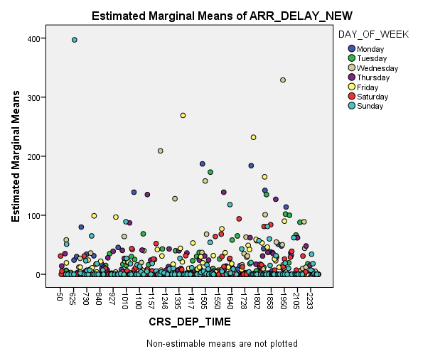
ANALYSIS
Notes:
13

Slide 14
ANALYSIS
In this analysis based on our data we identified the exact day of the week and a time slot within a day where there is maximum delay experienced by airline companies.
We conducted Two Way ANOVA test on the departure time and day of the week variables to analyze the significance level at the intercept of these 2 variables.
From the effects table we can conclude that the significance value is less than the significance level α (assumed to be 0.05). Hence, we reject the null hypothesis concluding that departure time and day of the week does have significant effect on the airline on-time performance.
The scatter plot also shows the exact day and time during the day, when airline experience delay i.e. airplanes which are scheduled on Friday evening.
Notes:
14

Slide 15
CONCLUSIONS
The major factor which impacts the airlines on-time performance is the Late Aircraft delay.
The delay value identified from our dataset is significantly different across different airline carriers. Frontiers airline company has experiences maximum delays in the past year. So, this analysis will help the customers in making decision while making reservations for their travels. It will also provide statistics to the airline company to work on their problems and provide better service.
Friday evening is the time period when maximum delays occur for departure of flights. This analysis can help customers to take decisions while making reservations. It will also assist the Airport authorities to take decisions on handling the airplane schedules to avoid delays.
Notes:
15

Slide 16
POSSIBLE OUTCOMES IF MORE DATA AVAILABLE
Availability of the air distance or the distance travelled by the airline. This would have enabled us to determine if distance has a significant affect on the on-time performance of the airline. Linear regression could have been used for the same.
Weather Conditions data was unavailable. This would have enabled us to significantly identify the cause of impact on the airline on-time performance.
Notes:
16

Slide 17
FUTURE SCOPE
Find top 10 tail numbers, airline companies, destinations and origins that are more likely to be late individually
Find the flight between destination airport and origin airport with least average late time.
Notes:
17

